Slide 1
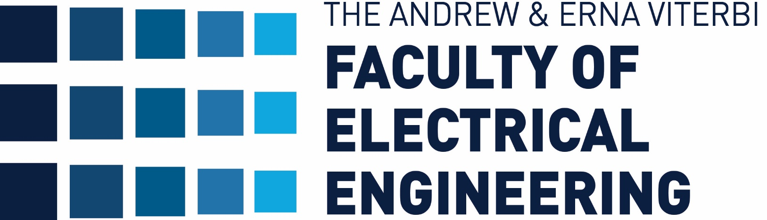
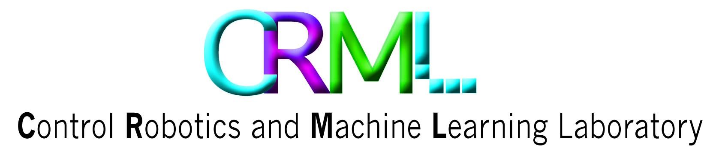

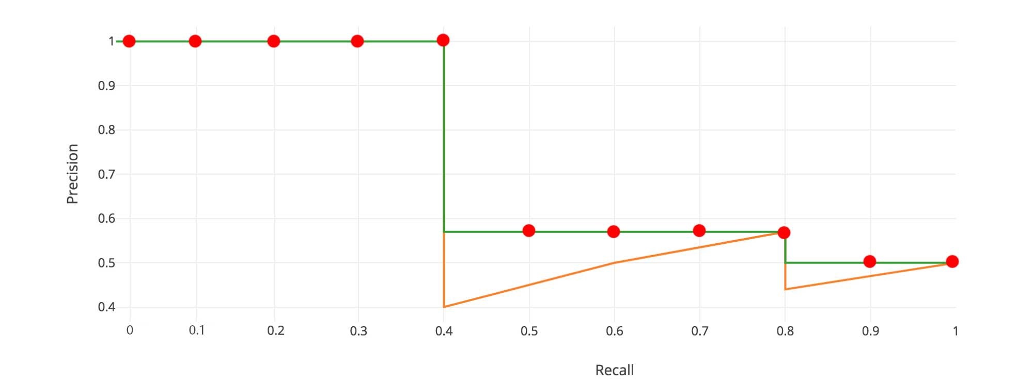
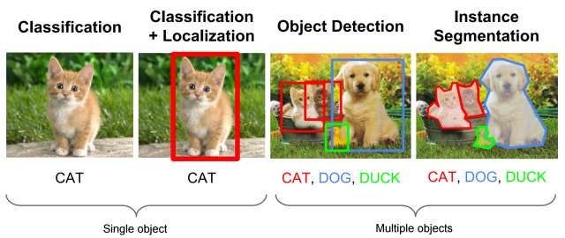
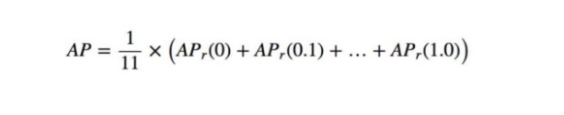
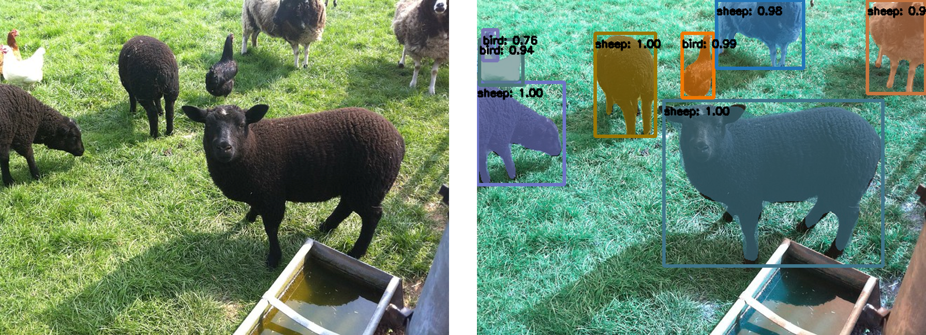
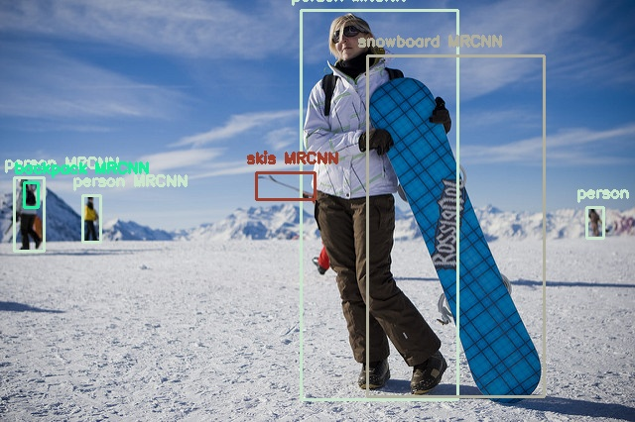
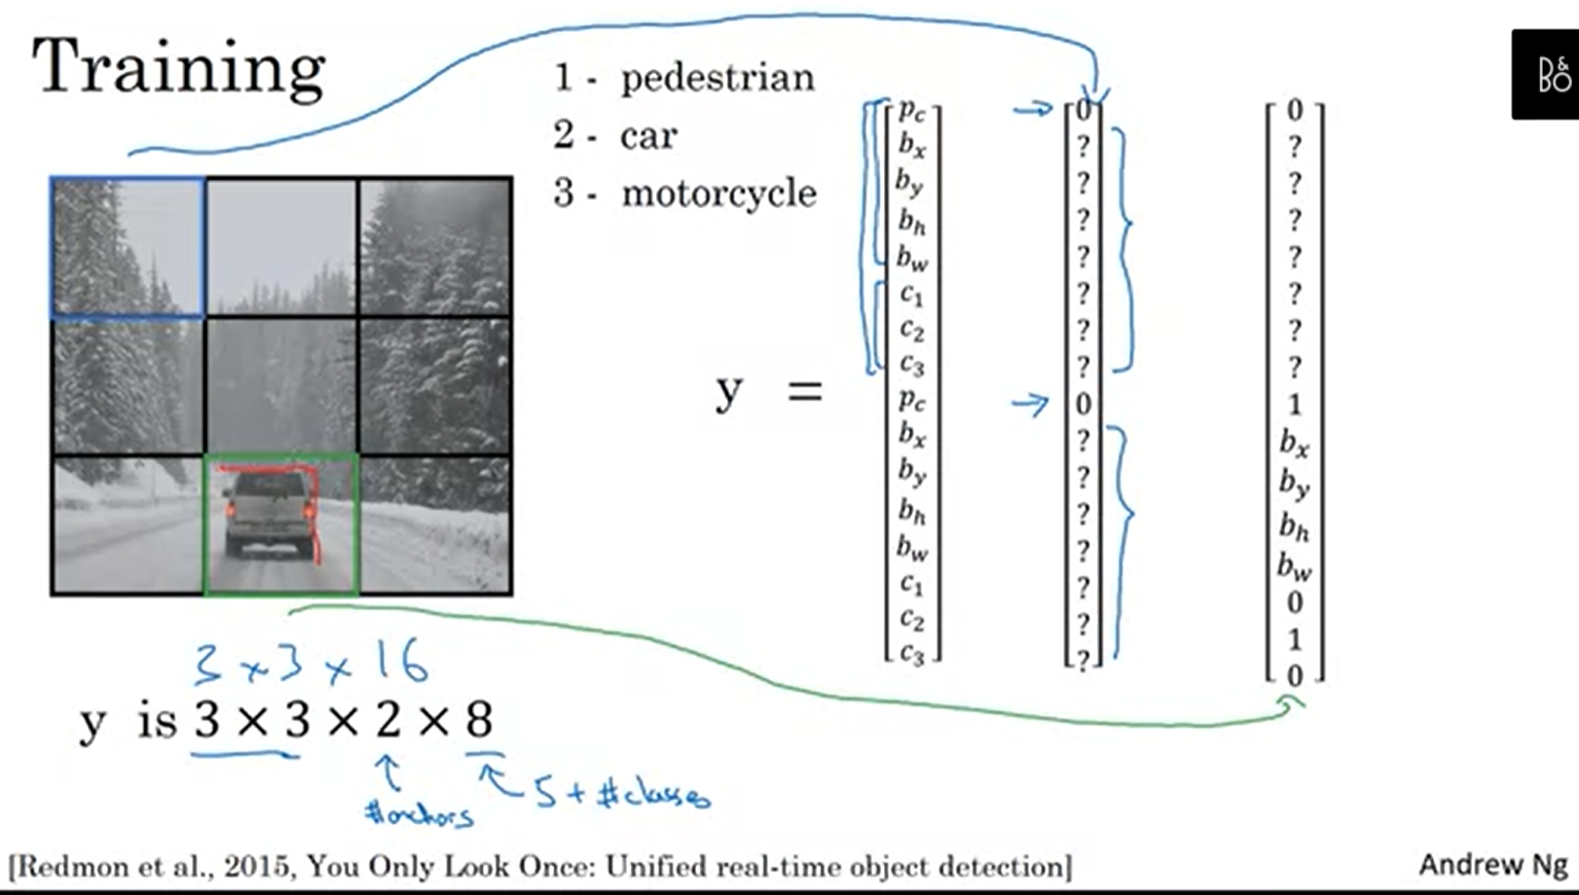
Improve Object Localization in Object Detection
Adi Mazuz , Dimitry Koltonov, Supervised by Roman Kaplan
Introduction
MRCNN
MAP
Object detection is a computer technology that deals with detecting instances of semantic objects of a certain digital images and videos.
We wanted to take two different object detection algorithms and improve their detections by combining their outputs in different ways
Mask R-CNN is an extension of Object detection algorithm Faster R-CNN with an extra mask head. The extra mask head allows us to pixel wise segment each object and also extract each object separately without any background
Models for object detection using regions with R-CNNs are based on the following three processes:
Find regions in the image that might contain an object.
These regions are called region proposals.
Extract CNN features from the region proposals.
Classify the objects using the extracted features.
In order to measure our predictions accuracy we used the MAP (mean average precision ) metric
MAP is a popular metric in measuring the accuracy of object classification
Predictions Groups
When combining a both outputs we received prediction which can be divided to 2 groups
Pairs : both algorithms identified the bounding box with the same classification
Singles: only one algorithms identified a certain perdition
These prediction sometimes contained false predictions
Filtering these prediction should increase our MAP result
Goals
A USV at sea
Examine serval approaches for object detection
Learn and understand Object detection algorithms
Establish a Working object detection environment
Improve the Results of individual algorithms by creating an improved system for object detection
Decision Rules
Naïve Decision rules
Challenges
From Pairs we choose the bounding box with the highest confidence
From Singles we tried 2 approaches
Take all singles
Take singles with confidence > X
Results
set up our environment , both YOLO and MRCNN required a lot of technical work
Studying each algorithm and its output
Creating our dataset
Predictions took a long time, creating our dataset consisting of 10K image took several days to process
Our most successful result is 65.95, which is an improvement of ~3% from using only MRCNN
Most of the Naïve decisions improved the MAP metric of each individual algorithm
Unfortunately, we did not improve our overall result using ML decisions
YOLO
ML Based Decisions
We used serval different approaches
1. using trees for both singles and pairs
2. using tree for pairs and a Neural network for singles
3. using tree for pairs and used Resnet50 for singles
We cropped the predicted bounding box from the image and inserting it to Resnet50, if Resnet identifies and object with confidence > 0.5 we take the prediction
Conclusions
YOLO is a clever convolutional neural network (CNN) for doing object detection in real-time.
YOLO is popular because it achieves high accuracy while also being able to run in real-time.
The algorithm “only looks once” at the image in the sense that it requires only one forward propagation pass through the neural network to make predictions.
Overall we get better results on naïve decision rule
We may improve our ML results by
using a bigger dataset
more parameters
Changing our NN architecture
using different ML algorithms such as SVM
September 2016

